Slide 1
Presented by: Ishaque Ramedies A school intercom system
Text-to-Speech synthesizer, profanity filtering
Benefits the visually impaired, or illiterate people
Remote technology

Slide 2
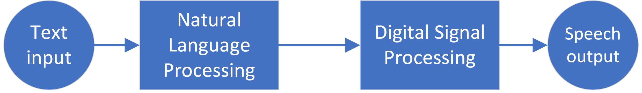
How is this done?

Slide 3
Natural Language Processing (NLP)
Units:
Tokenization
Part-of-Speech tagging
Normalisation
Phonetic transcription
Algorithms:
Hidden-Markov Model
Viterbi Algorithm
Generic Lookup Tables

Slide 4
Digital signal processing - Synthesizer
Features:
Synthesizes the phonemes of words:
Hello -> ‘H’, ‘AE’, ‘L’, ‘OW’
Lexicon is required
Synthesizer models the formants of phonemes.
Components:
Digital resonators
Amplifiers
Low-pass resonators
Impulse generators

Slide 5
Problems encountered
Data collection
Time consuming
Has to be accurate
E.g. Lexicons should have POS, syllable stress, and phonetic descriptions.
Consonant synthesis
Don’t explicitly follow the same rules as vowels.
Consist of a large number of tuning parameters.
Tuning
Synthesis cannot be achieved by simply modelling the formants, other parameters have to be considered (a very intricate process).

Slide 6
Results and evaluation
First requirement: Synthesized speech and normal speech should sound similar.
How to get this?
The outputs of both forms of speech is recorded.
The recorded speech is displayed on visualisation software (Praat).
The features of both speech signals are compared.

Slide 7
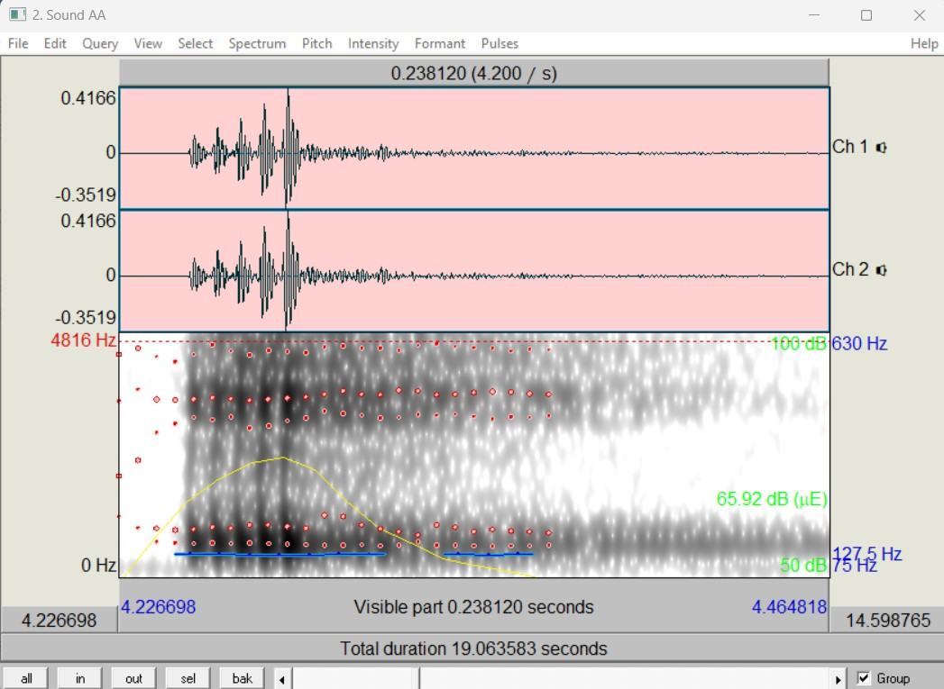
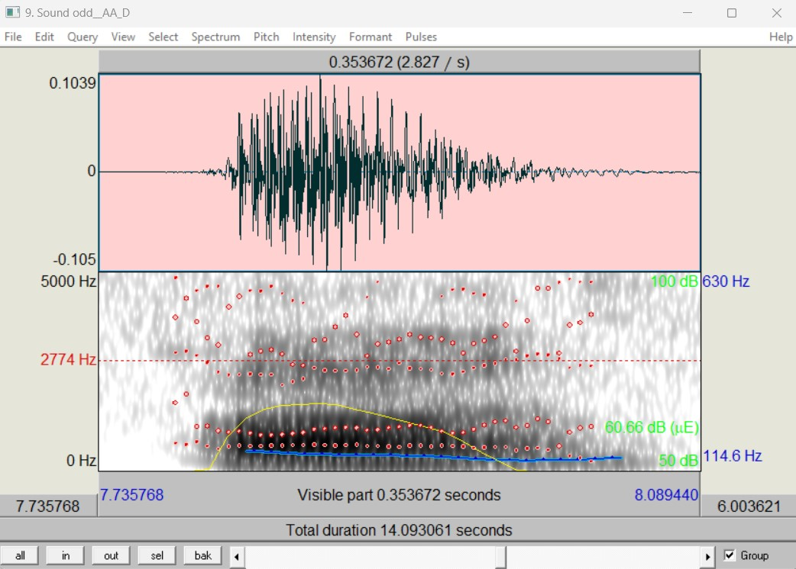
Example output (Qualification test 1)
Synthesizer
Natural

Slide 8
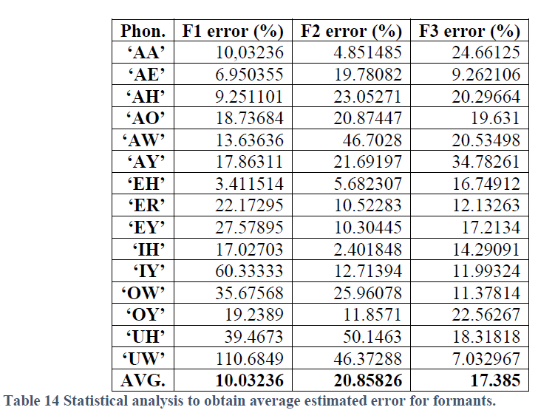
Results and evaluation

Slide 9
Results and evaluation
Second requirement: Expected WER of NLP below 40%.
How to get this?
Data set was split into test data and trained data.
The test data was tested with the algorithm and accuracy of the algorithm was evaluated.
Accuracy over 95% achieved.
Evaluates to expected WER of 5% or below.

Slide 10
Results and evaluation
Third requirement: 100% explicit profanity filtering accuracy.
Since a lookup table is used with a predefined list of profanity, the resulting accuracy will always be 100%.
Fourth requirement: Email display feature.
The text of the email is displayed through a browser, and it can be visually confirmed whether it aligns with the inbox of the intercom system.

